Slide 1


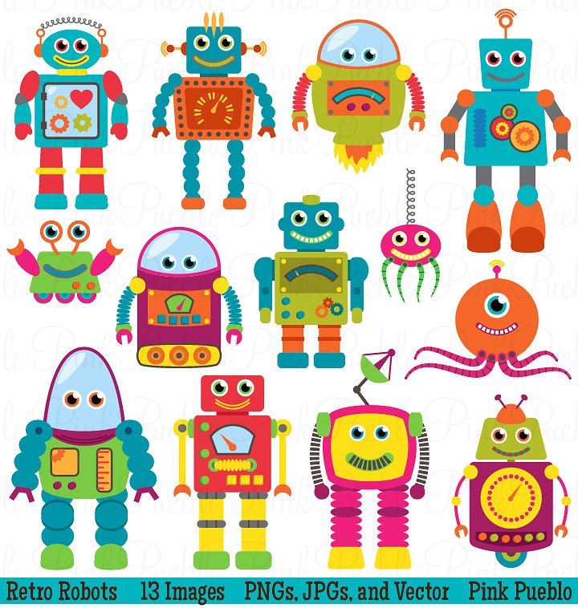


Master of Technology (IS)
Pepper Project Group
CAO LIANG | A0012884E
GENG LIANGYU | A0195278M
HAN DONGCHOU FRANCIS | A0195414A
ONG BOON PING | A0195172B
TAN CHIN GEE | A0195296M
Patient Matching System
Depression Screening System
Project Report

Slide 2
Contents
Executive Summary 3
Business Problem Background 4
Project Objectives & Success Measurement 5
Project Solution 6
Solution Design 8
Project Implementation 11
Project Performance & Validation 18
Project Conclusions: Findings & Recommendation 23

Slide 3
Executive Summary
This project is a continuation from the Depression Screening System group project completed during the Machine Reasoning course. As a recap, the Depression Screening System deals with the problem of depression in youths and vulnerable segments of the community going undetected and untreated. It serves as an early warning system to put a spotlight on those vulnerable individuals who are displaying symptoms of depression. These vulnerable individuals can be spotted through the PHQ-9 Survey framework devised with the Depression Screening System. The output from that system is to provide a diagnosis (with a PHQ-9 score) on the level of severity of depression the individuals are having.
In this phase of project, the objective is to use the PHQ-9 scores of the individuals and match them to the many practitioners in the community partners, hospitals and IMH.
Why Patient Matching? When we churn out a list of patients in batches as part of the PHQ-9 Survey, there is also a need to do the matching with practitioners in batches. There are some challenges to match patients to practitioners. First of all, practitioners fall into roughly 3 categories – Counsellors, Psychologists, Psychiatrists. Then there is the time availability of the practitioners, as well as language ability, which are all hard constraints. Also there is location preference and gender preference which are soft constraints. Then there is the cost based on the practitioner selected, which is a soft constraint to minimize it.
Using the State Space Search techniques embedded in the OptaPlanner, the Patient Matching System is able to optimally match a group of patients against a group of practitioners. The detail of how this match is executed will be covered in the next chapters.
This system provides benefits to those who are diagnosed with depression by matching appropriate practitioners with the right expertise and in accordance to some set constraints.

Slide 4
Business Problem Background
In the Depression Screening System, the test candidates are given the PHQ-9 scores indicating the level of severity of the depression.
With the current project, the Patient Matching System matches patients with mental health practitioners based on two hard constraints and four soft constraints. The hard constraints are patients’ depression severity and language ability. The soft constraints are patients’ preferences for the day of the appointment, where the practitioners are located, gender of the practitioners, and treatment costs.
Starting with the hard constraints, our system scores the severity of a patient’s depression with a number from 0 to 27. Patients with scores between 10 to 27 require treatment. A score between 10 to 14 indicates that a patient is moderately depressed, and the patient should see a counsellor. A score between 15 to 19 indicates that a patient’s depression is moderately severe, and the patient should see a psychologist. A score between 20 to 27 indicates that a patient is severely depressed, and the patient should see a psychiatrist.
Patients and mental health practitioners need to communicate and understand each other during treatment. The system pairs patients with mental health practitioners who share at least one language in common. Patients and mental health practitioners can speak one or more of these languages: English, Mandarin, Malay or Tamil.
Our system optimizes the matching of patients with practitioners through fulfilling four soft constraints. Patients will indicate a day of the week, Monday to Sunday, that they preferred to see the practitioners. The system will try to match patients with practitioners who are available on the preferred day.
Patients will indicate where they would prefer to see the practitioners. There are five regions to choose from: Central, East, North, Northeast, and West. The system will try to match patients with practitioners working in their preferred regions.
Patients will indicate whether they prefer to see female or male practitioners which the system will try to match accordingly.
Finally, the system will try to pair patients with practitioners that have lower treatment costs to keep the overall healthcare expenditure low.

Slide 5
Project Objectives & Success Measurement
The objective of this project is to optimally match patients with practitioners, both in groups. The outcome of this match will be such that all patients will be assigned matching practitioners.
We will be monitoring whether the system is able to meet the hard constraints and soft constraints during this matching exercise to see how good the application is in avoiding hard constraints and minimizing soft ones. This will provide us with a gauge as to how well the application is able to perform the matches.
The hard constraints are
patients’ depression severity
language ability
The soft constraints are
patients’ preferences for the day of the appointment
where the practitioners are located
gender of the practitioners
treatment costs.
Notes:
One in four young Singaporeans show signs of depression. IMH treated 600 youths between 20 to 29-years-old last year alone.
And one out of four people admitted to suffering from multiple symptoms of depression in a recent survey of youths aged 18 to 25. The study was conducted by students from Wee Kim Wee School of Communication and Information in NTU.
We know that depression may lead to suicide. But other times, its sufferers become less productive and are more at risk for other diseases.
The latest statistics on depression don’t paint a pretty picture of progress but it shows that the condition is more common than we think. Yet the stigma surrounding it walls off the victim who often suffers in silence.
We need to seek out those who need help, and help them early. However, the challenge is that we do not have enough practitioners to do that.
One way to tackle this problem is to adopt a pro-active approach to seek out those who need professional assistance. The objective of this project serves to do just that with the help of Artificial Intelligence. With AI, we could apply some techniques like Certainty Factor, Decision Tree, and Inference Diagram to automate the screening of candidates. The screening is done at three levels:
Identifying the high risk group – Risk Profiling
Doing a 2-question survey (PHQ2)
Doing a 7-question survey (PHQ9)
Level #1 can be applied to any organization, be it a school, a workplace, or even just targeting a segment of people.
Once level #1 is done, those identified candidates can proceed to Level #2 and level #3 in a survey setting so that we can ascertain whether the candidate would likely be suffering from depression, and then recommending the next steps.

Slide 6
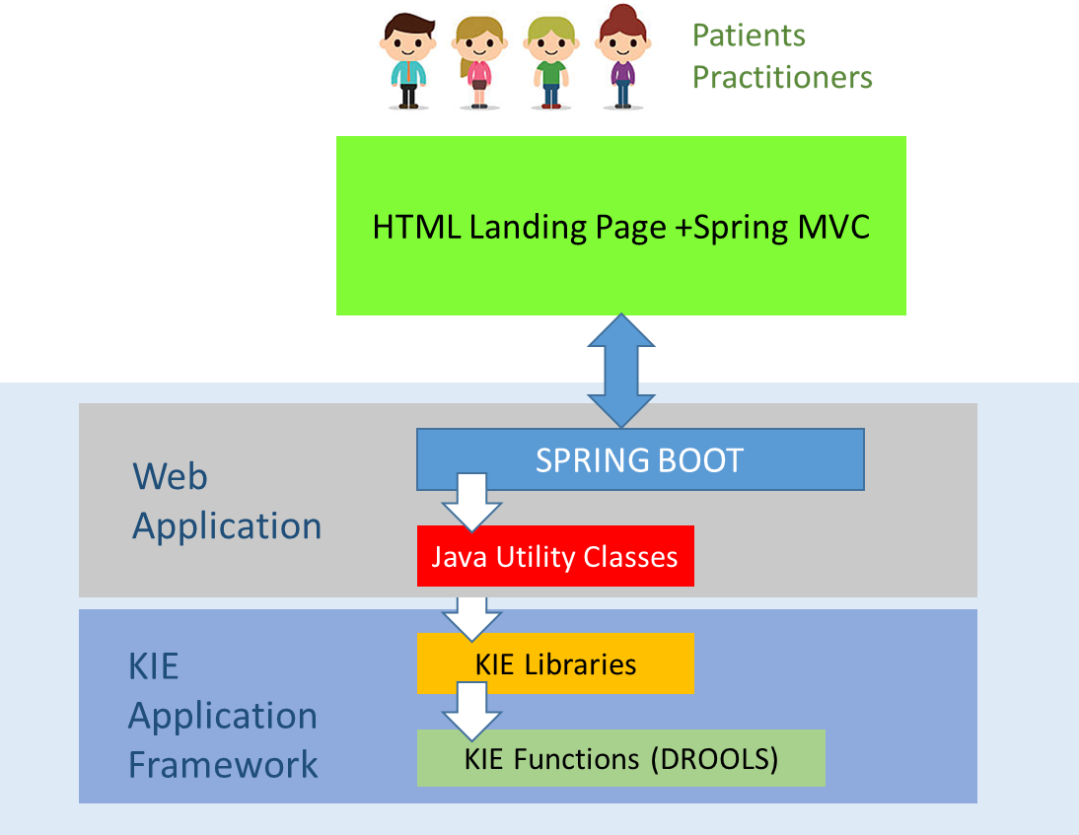
Project Solution
Architecture
This application leverages the KIE Workbench as the main framework for development and deployment. With the KIE Workbench, we utilize the JBPM for metadata and workflow, DROOLS for rules engine and the JBOS Web Server to provide the web application server functions. In addition, we are using the Spring Boot to program the landing page, front-end screens and interface with KIE.
A lot of effort was spent on integrating the Spring Boot web application with the KIE framework through our self-coded Java classes.
This allows the user to not only interface with an external HTML page but also stay on the HTML frontend throughout the entire process. Behind this frontend, our custom built web application interfaces with the KIE libraries via the Java classes.
Derby
DB
OptaPlanner
Application
Framework
OptaPlanner Libraries
DROOLS Libraries

Slide 7
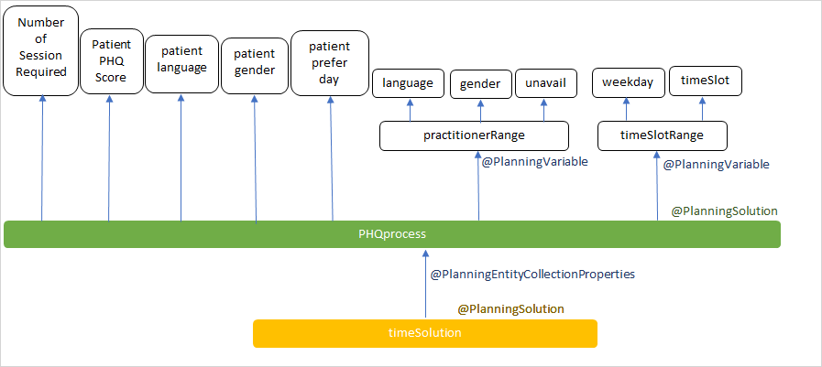
Project Solution
Design – Class Diagram
The following figure shows the Class Diagram for the application. This class diagram shows that, using OptaPlanner, we are trying to match a group of patients to a group of practitioners based on Period and Practitioner.
In the first attempt, we named the planning solution as timeSolution, planning entity as PHQprocess. Hard Soft Score is chosen as the score type.
In TimeSolution, the list of practitioners and list of time slot are linked to the practitioner, time slot in the PHQ process. The planning variable is defined to be a many to one relation in between planning solution and entity.
Also,we defined the process to include patients’ detail, namely, ID, name, PHQ Score, preferred location, prefer day of session, gender and language.

Slide 8
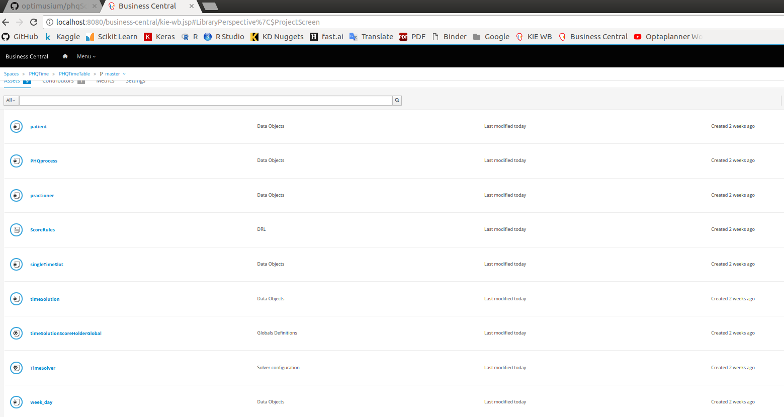
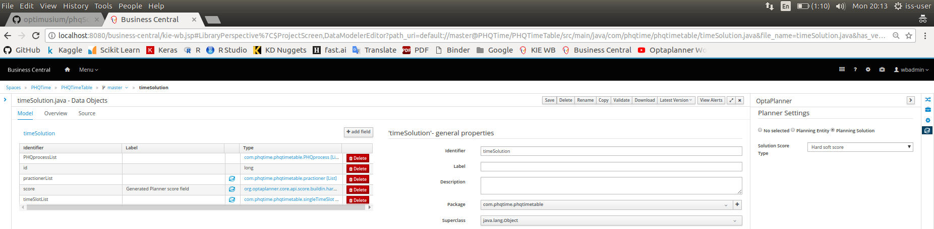
Project Implementation
KIE Workbench Setup
The following screens show the setup in KIE Workbench based on the original design.

Slide 9
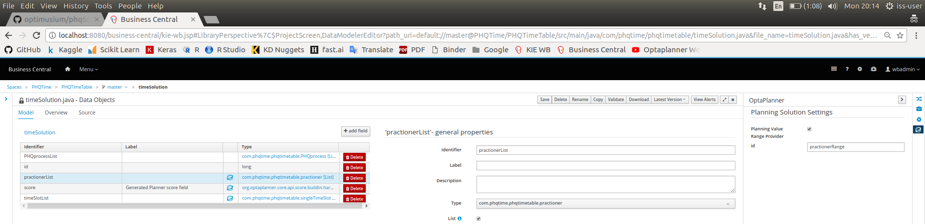

Project Implementation
KIE Workbench Setup

Slide 10
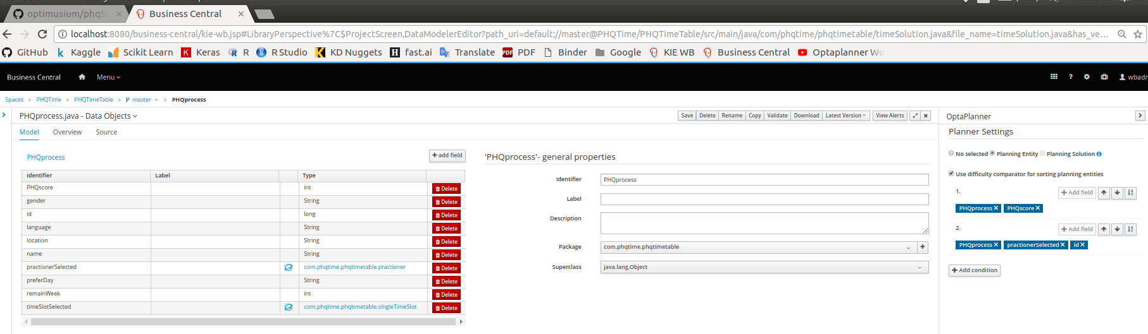
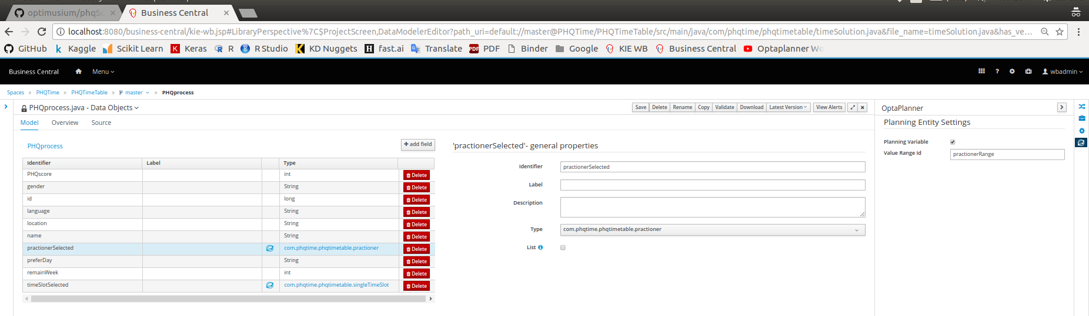
Project Implementation
KIE Workbench Setup

Slide 11
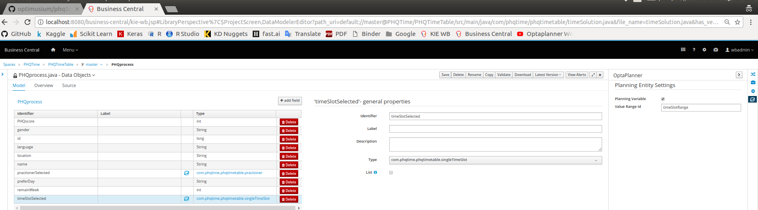
Project Implementation
KIE Workbench Setup

Slide 12
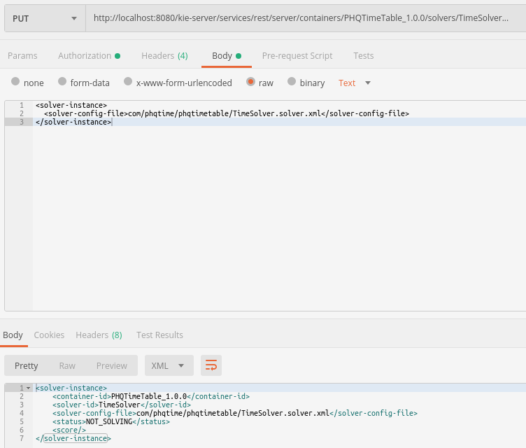
Project Implementation
KIE Workbench Setup
Nest we use the Tool Postman to test the OptaPlanner application.

Slide 13
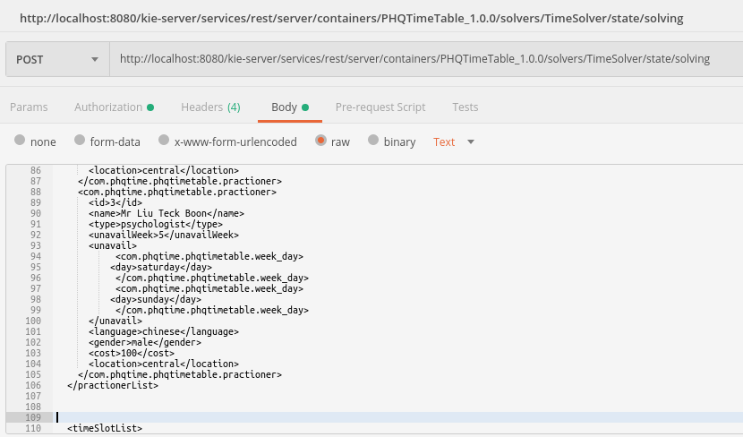
Project Implementation
KIE Workbench Setup
When using the construction heuristics, we choose to use First Fit Decreasing. This is to enable us to quickly construct the initial solution.
We started with a very simple search consisting of 3 patients and 3 practitioners, using First Fit Decreasing.
As the State Search Space got larger however, we realize that First Fit Decreasing does not work very well.
Initial testing for First Fit Decreasing with only 3 practitioners and 3 patients

Slide 14
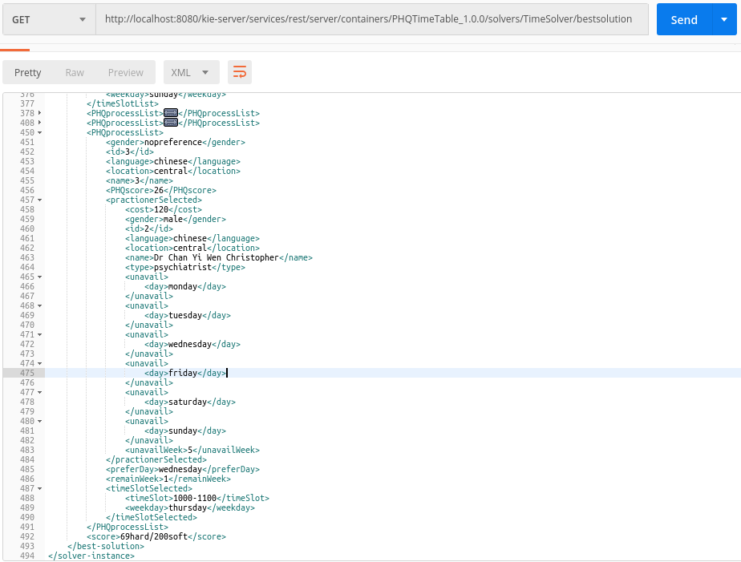
Project Implementation
KIE Workbench Setup
The search outcome for First Fit Decreasing with the small Data Set is successful with a Hard score of 69 and a Soft score of 200.

Slide 15
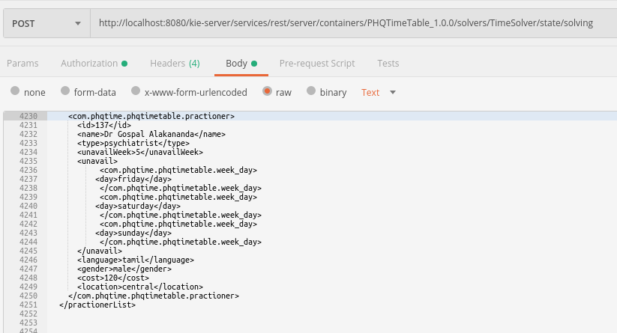
Project Implementation
KIE Workbench Setup
Next we perform a test on this First Fit Decreasing search with a bigger data set → 137 practitioners and 134 patients

Slide 16
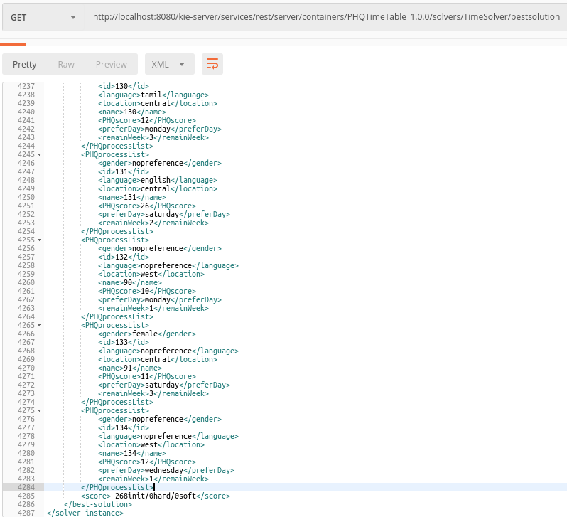
Project Implementation
KIE Workbench Setup
First Fit Decreasing search is fails with this bigger data set of 137 practitioners and 134 patients

Slide 17
Project Implementation
KIE Workbench Setup
Hence, a local search is added, and Late Acceptance search is chosen in this case.
By adding Late Acceptable search after first fit, we aim to generate a solution for 137 practitioners and 134 patients.

Slide 18
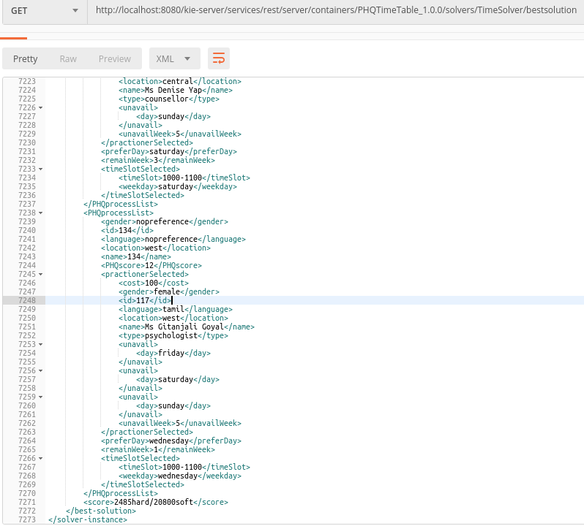
Project Implementation
KIE Workbench Setup
Outcome for First Fit Decreasing with Late Acceptance search is Positive with this bigger data set of 137 practitioners and 134 patients

Slide 19
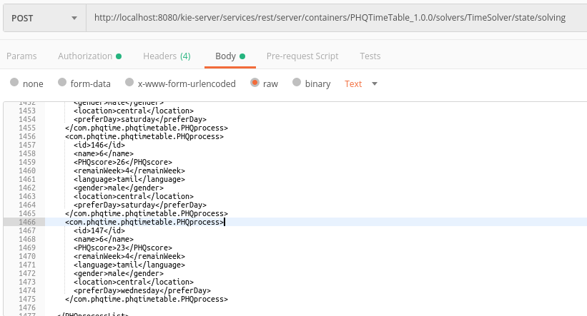
Project Implementation
KIE Workbench Setup
Traditional Hill Climbing has the tendency to be stuck at local optimum but Late Acceptance Hill Climbing increases the chance the to find the global optimum.

Slide 20
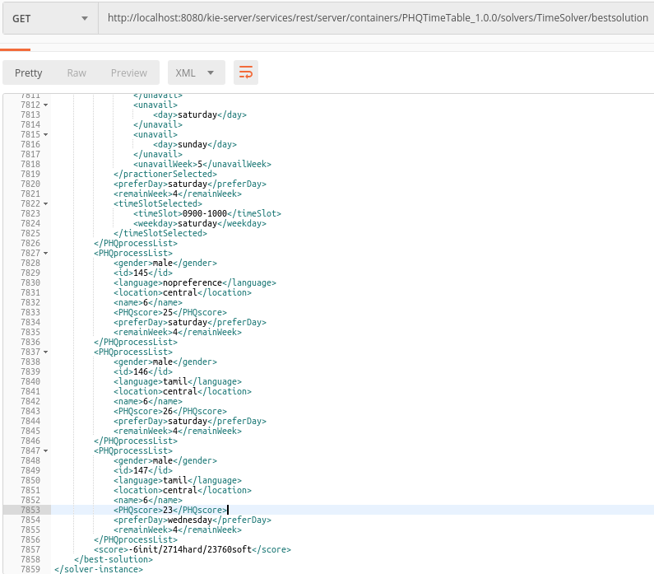
Project Implementation
KIE Workbench Setup
Result showing that Hill Climbing getting stuck at local optimum.

Slide 21
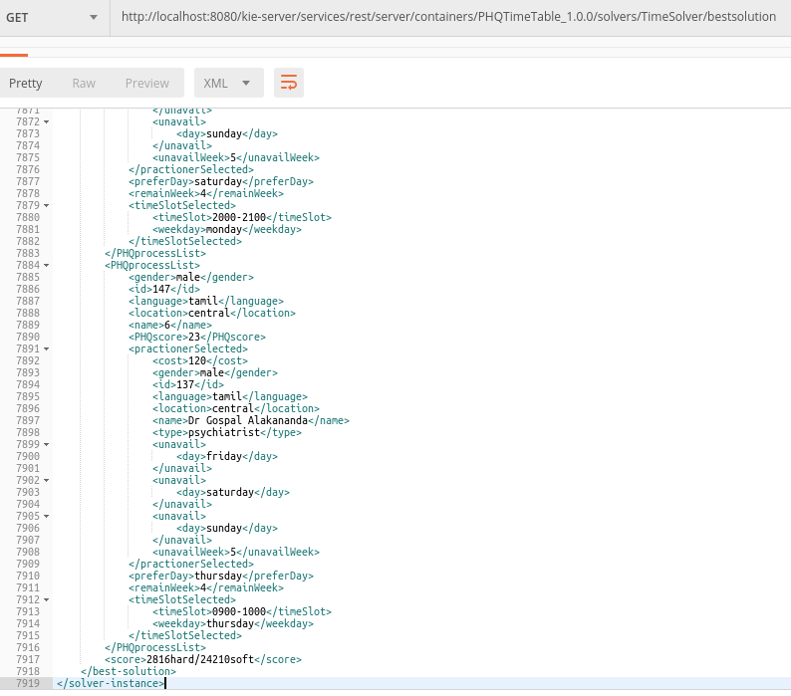
Project Implementation
KIE Workbench Setup
Result showing Late Acceptance Hill Climbing solving the problem.

Slide 22
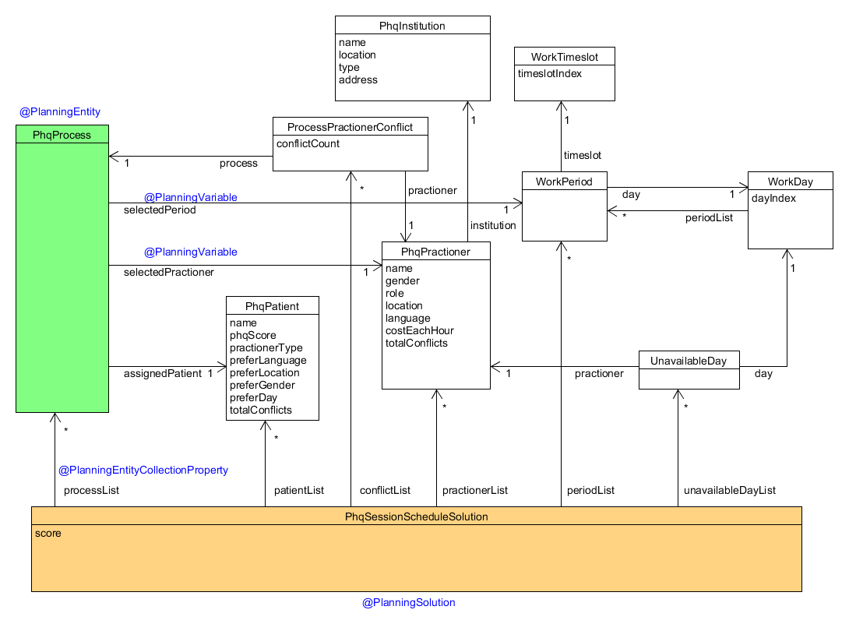
Project Solution
Design – Class Diagram
After the tests based on earlier design, we made some improvements as follows.
Migrate from KIE Workbench to Eclipse and incorporate the use of Java Maven libraries
On KIE environment, the memory process is intensive and the OtaPlanner is limited to several functions (cannot tune the late acceptance properties and etc).
Hence, using Java Maven libraries to enhance the model.
Enhanced some of the Data Objects, resulting in the following Class Diagram
Subsequent test results are obtained based on this new structure.

Slide 23
Project Implementation
KIE Workbench Setup

Slide 24
Solution Design
UUU

Slide 25
Solution Design

Slide 26
Project Implementation
Data Setup

Slide 27
Project Implementation
TTT

Slide 28
Project Implementation
OOO

Slide 29
Project Implementation
III

Slide 30
Project Implementation
GGG

Slide 31
Project Implementation

Slide 32
Project Performance & Validation
As mentioned in this document, Success Measurement for this application would be based on its ability to ….

Slide 33
Project Performance & Validation
2. PHQ2

Slide 34
Project Conclusions: Findings & Recommendation
From this project, we are able to ….

